Slide 1
Group 1 Truss project
Presented by Charity Fischer

Slide 2
Group 1 Truss Project
Participants
Abdulrahman Almarwan
Brandon Steup
Charity Fischer
Jeanie Hess

Slide 3
Group 1 Truss Project
Objective
Equipment
Build a truss
Calculate three force members using the method of sections
Measure the three selected force members using Pasco Universal Interface
Pasco truss members
3 load cells
2 1000g weights
Pasco 850 Universal Interface
Jfmatrix.com/analysis

Slide 4
Group 1 Truss Project
Set-up
Build a truss with
One end on a roller
One end on a hinge
Two points with applied downward force of1000 grams
That is 72cm wide and 18cm tall
Select three members to solve
We chose AB, BC, and GD

Slide 5
Group 1 Truss Project
Procedure
First find the moment about point E to solve for A_{Y}
Second find the moment about point G to solve for F_{BC}

Slide 6
Group 1 Truss Project
Procedure
Solve the sum of forces in the Y direction of a section to find F_{AB}
Solve the sum of forces in the Y direction of a section to find F_{GD}

Slide 7
Group 1 Truss Project
Procedure
Solve the sum of forces in the Y direction of a section to find F_{AB}
Solve the sum of forces in the Y direction of a section to find F_{GD}

Slide 8
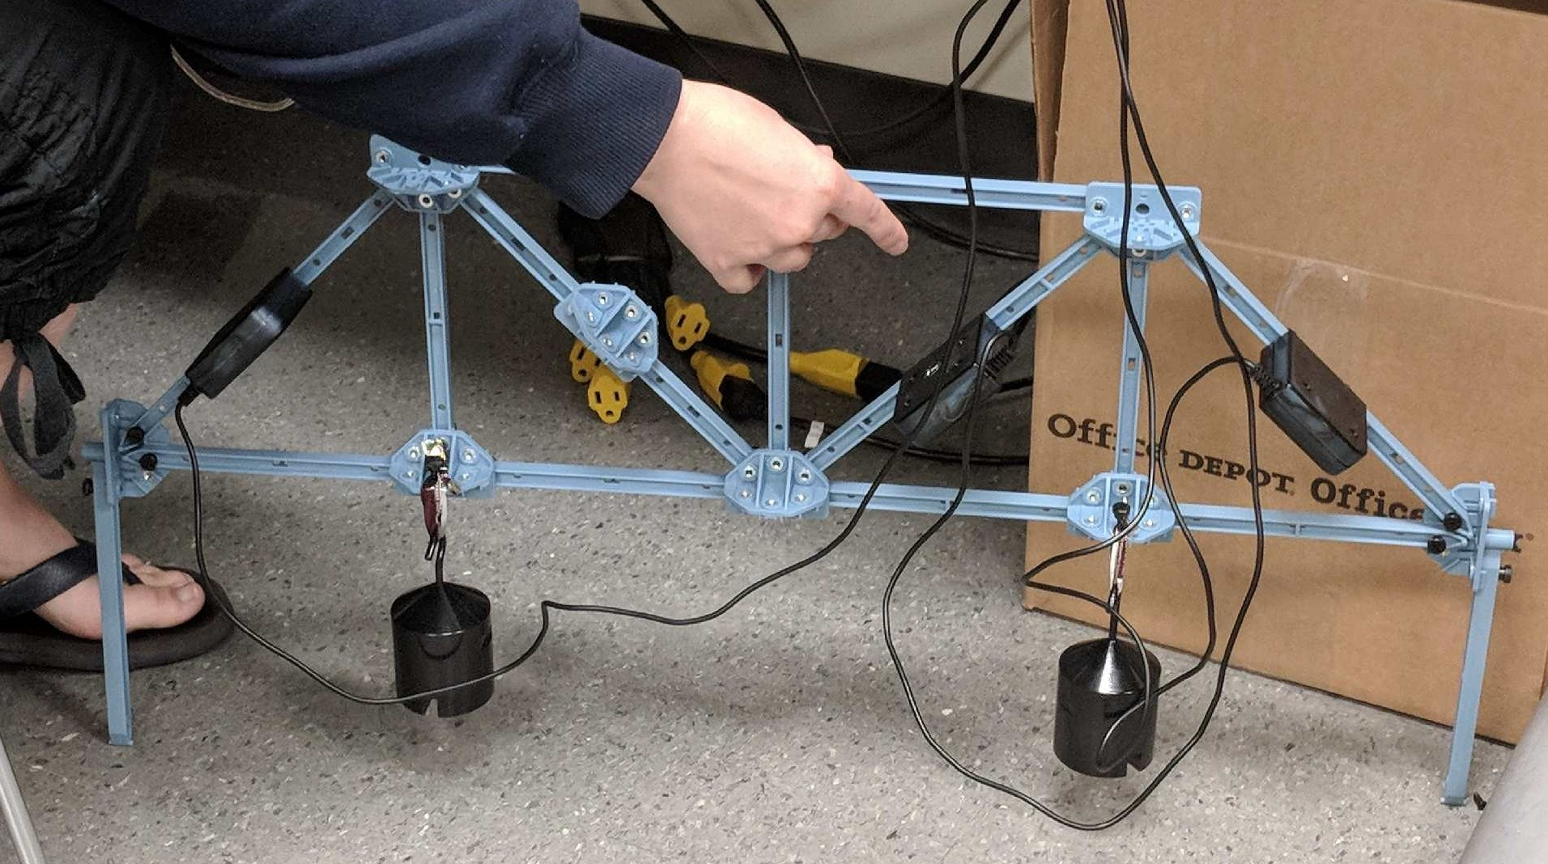
Group 1 Truss Project
Procedure
Next was the physical experiment using the Pasco Truss members
The 1000g weights were placed in equal distances from the middle and the end of the truss
The load cells attached to the truss were plugged into the Pasco 850 Universal Interface
Five samples of data were taken per load cell

Slide 9
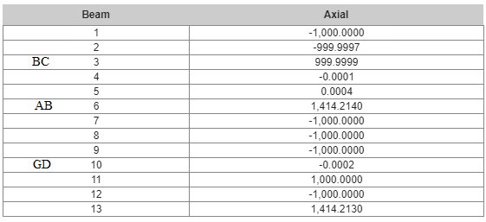
Group 1 Truss Project
Physical Experiment
Paper Calculations
 | Grams
 | AB | BC | GD
 | 1471.429 | 1101.02 | -46.9388
 | 1462.245 | 1109.184 | -55.102
 | 1454.082 | 1096.939 | -53.0612
 | 1484.694 | 1117.347 | -53.0612
 | 1475.51 | 1113.265 | -47.9592
Average | 1469.592 | 1107.551 | -51.2245
A_{Y}=1000g
F_{BC}=1000g
F_{AB}=1414g
F_{GD}=0
Results:
 | Fab | Fbc | Fgd
Paper | 1414 | 1000 | 0
jfmatrix | 1414.214 | 999.9999 | -0.0002
Physical | 1469.592 | 1107.551 | -51.2245
Average | 1432.602 | 1035.85 | -17.0749
Jfmatrix Calculations

Slide 10
Group 1 Truss Project
Observations
The Force of GD in the real world measurement varied greatly from the results in both our paper calculations and the jfmatrix analysis most likely due to deformation of plastic, angle of load, etc.
It’s good to work in groups for the sake of checking work and results

Slide 11
References
http://jfmatrix.com/Analysis
Engineering Mechanics: Statics, r.c. Hibbeler

